Slide 1
Phase 2: Requirements analysis

Slide 2
Static Model & Communication Diagram
Requirements Analysis
Develop the static model for the online shopping mall, which depicts the classes and their relationships. A class can be classified as a boundary class, entity class, control class, or application logic class. Define the attributes of each entity class.
Develop the communication model depicting objects participating in each use case and the sequence of interactions among the objects. A use case is modeled using a communication diagram.

Slide 3
Static Modeling
Define structural relationships between classes
Depict classes and their relationships on class diagrams
Static Modeling
In OO Analysis Modeling
Define classes in system
Defines attributes of classes
Defines relationships between classes
Defines operations of each class
Relationships between classes
Associations
Composition / Aggregation
Generalization / Specialization

Slide 4
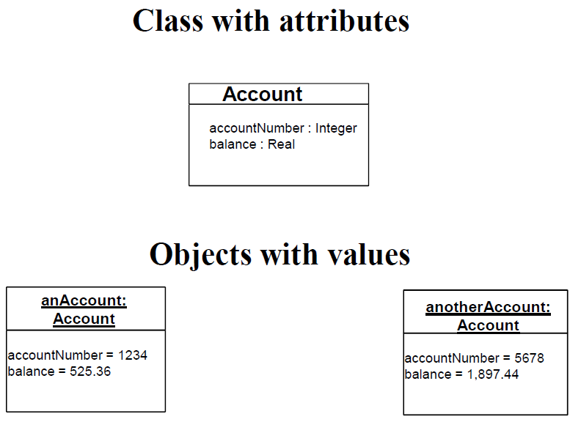
Example of classes with attributes
Use UML notation of classes

Slide 5
Association
Association is
static, structural relationship between classes
E.g, Employee works in Department
Multiplicity of Associations
Specifies how many instances of one class may relate to a single instance of another class
Examples
1-to-1 association
1-to-many association
Optional association (0 or 1)
Optional association (0, 1, or many)

Slide 6
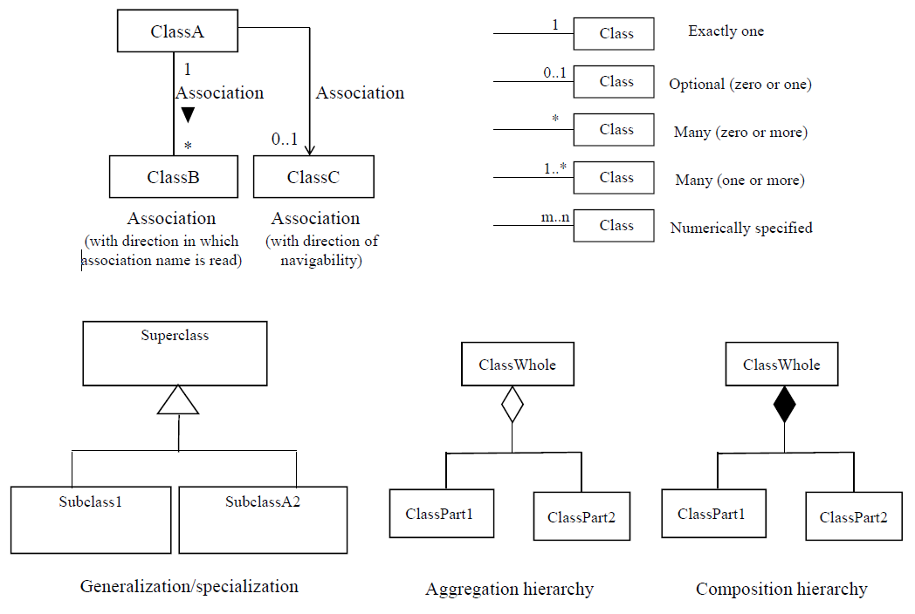
UML notation for relationship on class diagram

Slide 7
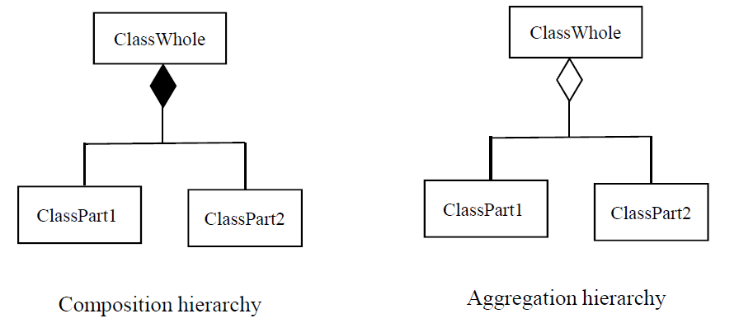
Composition and Aggregation Hierarchies
Whole/Part Relationships
Show parts of more complex class
Is part of Relationship
Between part classes and whole class
Composition is stronger relationship than aggregation

Slide 8
Composition Hierarchy
Whole and part objects are created, live, die together
Often also has a physical association
Association between instances
E.g., Composite class
ATM
Part classes

Slide 9
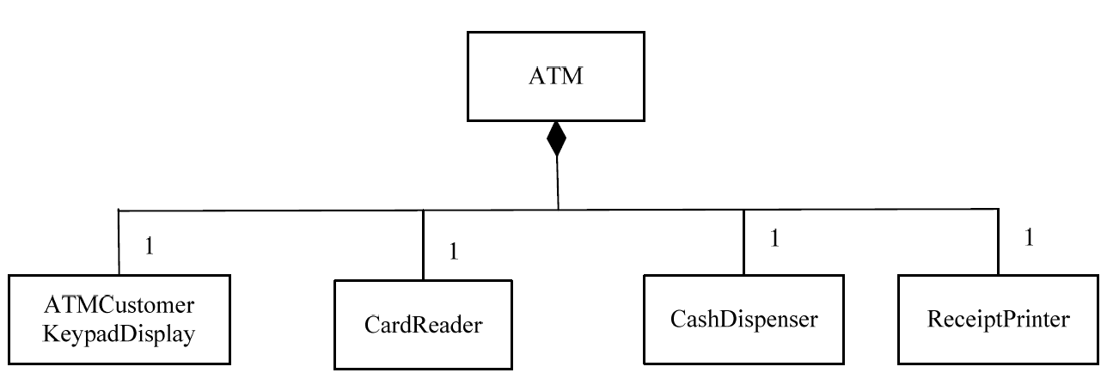
Example of Composition Hierarchy

Slide 10
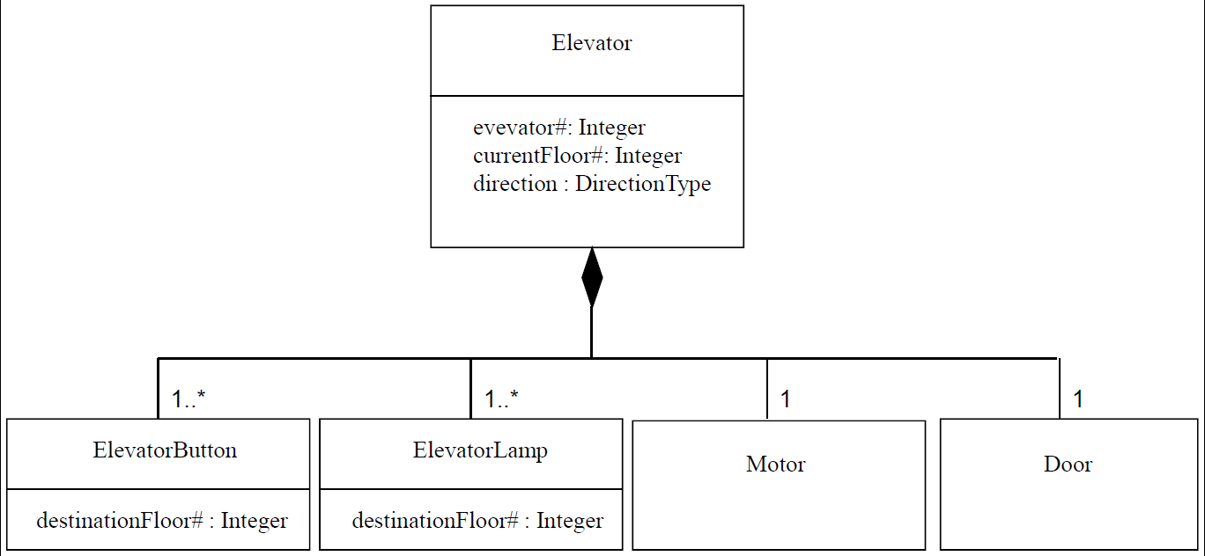
Example of Composition Hierarchy

Slide 11
Aggregation Hierarchy
Part objects of aggregate object may be created and deleted independently of aggregate object
E.g., Aggregate class
College

Slide 12
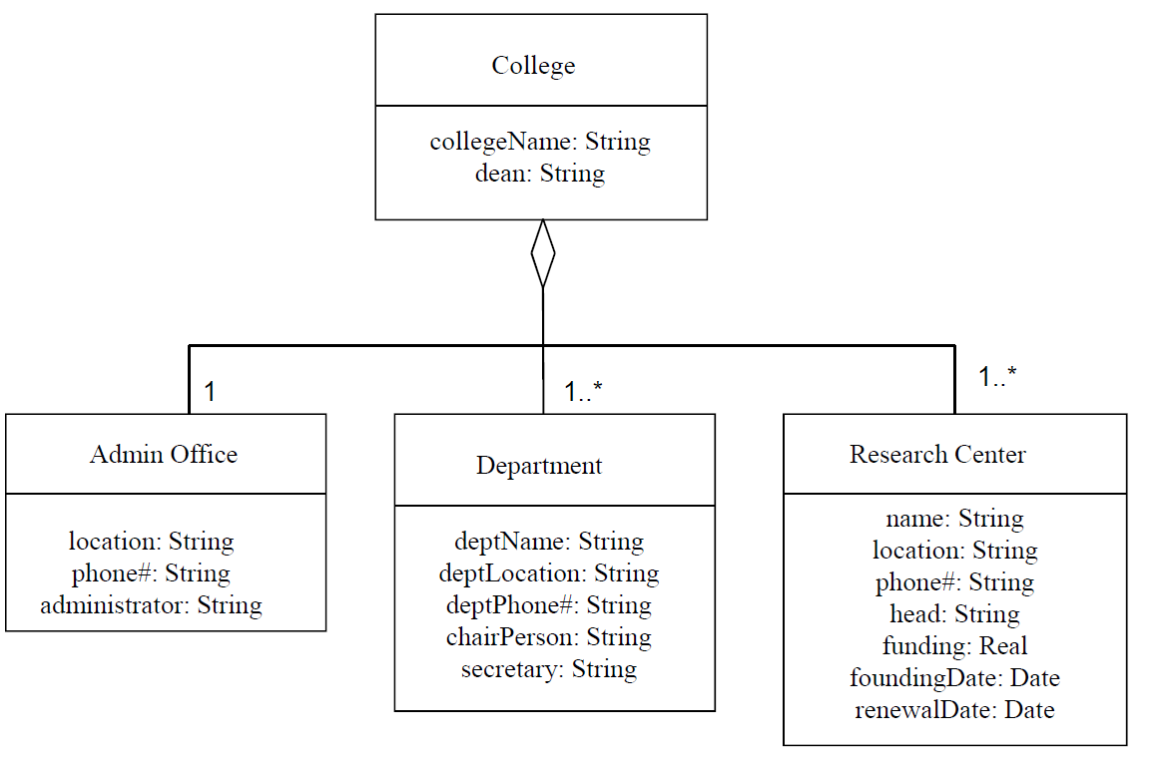
Example of Aggregation Hierarchy

Slide 13
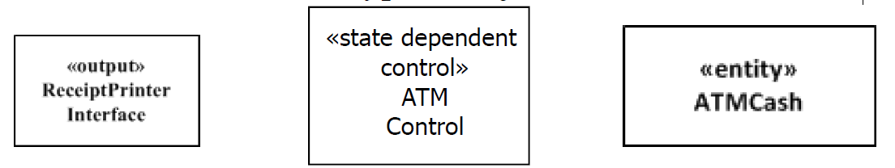
Object and Class Structuring Criteria
Objective:
Determine all software objects and classes in system
Use Object and Class Structuring Criteria
Guidelines for identifying objects and classes
Structuring criteria depicted using stereotypes
Stereotype
Defines role of class or object in application
Depicted using angle brackets, e.g.,
«entity», «output», «control»
Class has same stereotype as objects instantiated from it

Slide 14
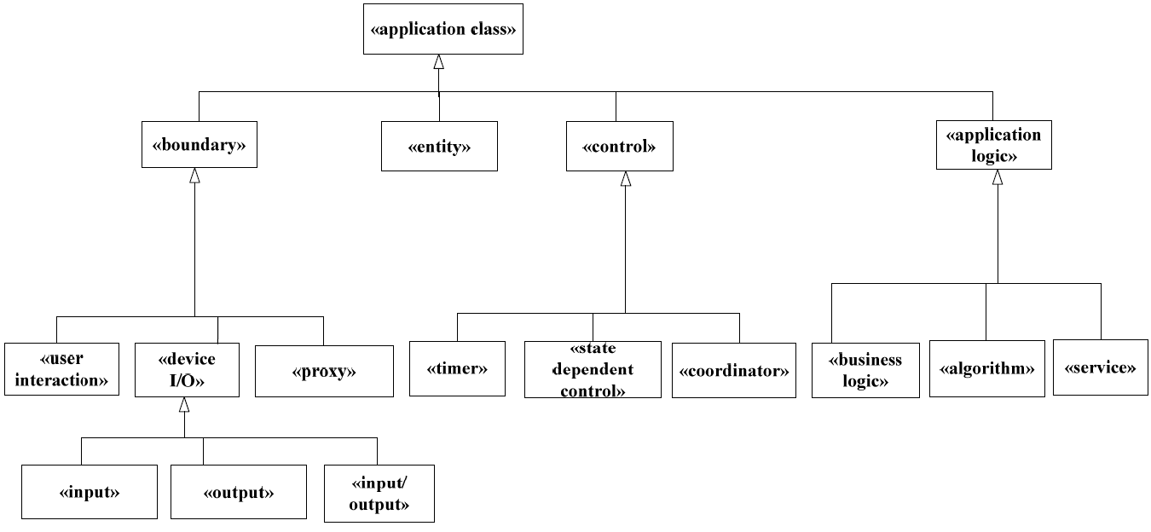
Classification of application classes using stereotypes
Use the stereotypes below only. Do not come up with other stereotypes!!

Slide 15
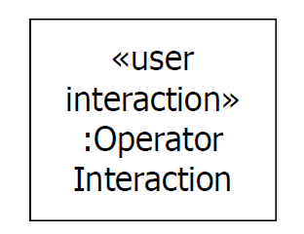
Object Structuring Criteria
Boundary object
Software object that interfaces to and communicates with external environment
Each software boundary object interfaces to an external (real-world) object
User interaction object
Device I/O object
Proxy object
For each software boundary object
There is a corresponding external object

Slide 16
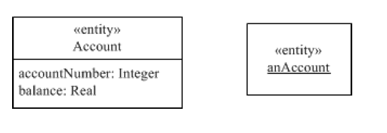
Entity Classes and Objects
Entity objects
Software object that stores information
Instance of entity class
E.g., Account, Customer
Determined during static modeling
Entity classes and relationships shown on class diagram

Slide 17
Object Structuring Criteria
Control objects
Provides overall coordination for execution of a group of objects
Makes overall decisions
Decides when, and in what order, other objects participate in interaction sequence
Control objects
Coordinator object
State dependent control object
Timer object

Slide 18
Application Logic Objects
Application Logic Object
Software object that contains details specific to application
Application Logic Objects
Business Logic Object
Algorithm Object
Service Object
Autonomous self-contained object
Provides a service to other objects
Responds to requests from client objects

Slide 19
Dynamic Interaction Modeling
Use cases realized in Dynamic Interaction Model
Show objects participating in each use case
Determine how objects participate in use case
Use object structuring criteria to determine objects
Stereotype for each object structuring criterion
Shows sequence of object interactions in use case
Depict on
communication diagram or
sequence diagram

Slide 20
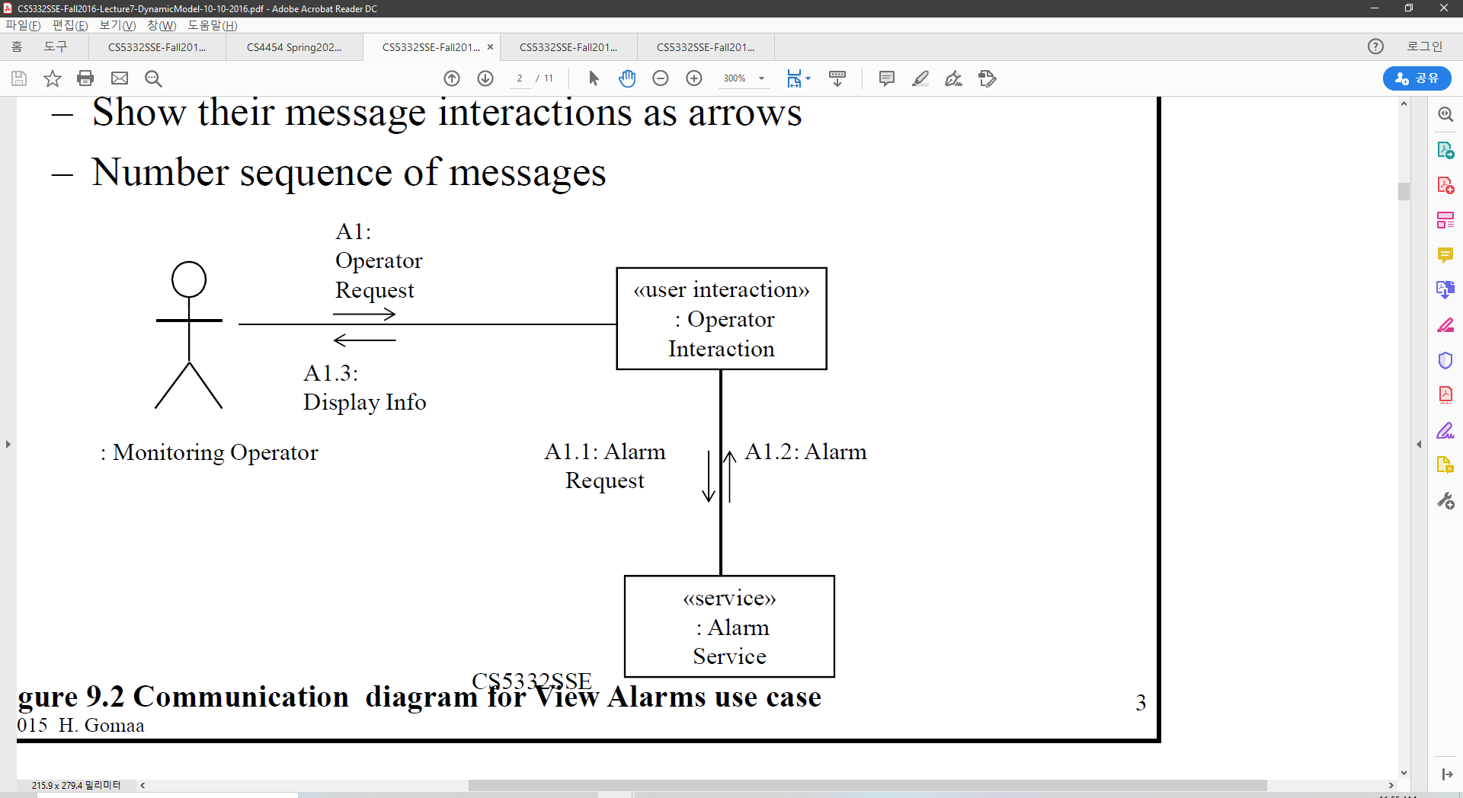
Communication Diagram
Graphically depicts objects interacting with each other
Show objects as boxes
Show their message interactions as arrows
Number sequence of messages

Slide 21
Dynamic Interaction Modeling
Start with use case
Determine boundary objects
Receives external events from actor
Determine internal objects
Receive messages from boundary objects
Determine Control object if needed
Control object
Executes state chart
Activates/deactivates other objects

Slide 22
Dynamic Interaction Modeling
Determine object interactions
Sequence of messages passed
Develop main interaction sequence (scenario)
Develop alternative sequences
For alternative branches of use case
E.g., for error handling or less frequently occurring conditions

Slide 23
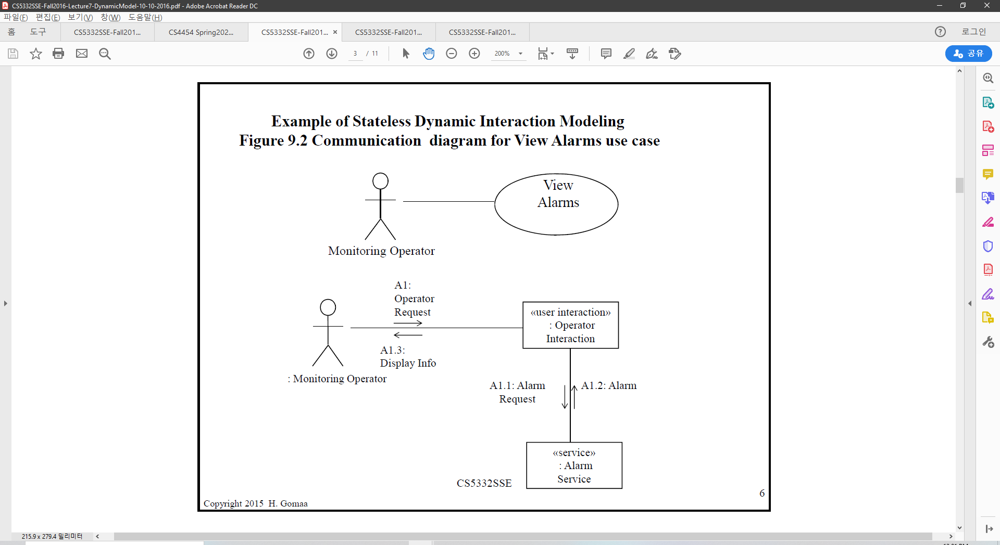
Communication diagram for View Alarms use case
Notes:
Cannot acces directly from actor to the interactions it is virtual.

Slide 24
Message Sequence Numbering
Form of message sequence number
[first optional letter sequence][numeric sequence][second optional letter sequence]
First optional letter sequence - use case id
Numeric sequence
Message sequence starting with external event
A1, A2, A3
Interactive System
Whole number for external event
A1, A2
Decimal number for subsequent internal events
A1.1, A1.2,A1.3, …,A2, A2.1, A2.2,…

Slide 25
Message Sequence Numbering
Second optional letter sequence
Concurrent event sequences
A3, A3a
Alternative message sequences
D1[Normal], D1A[Error]
Describes sequence of object interactions
Narrative description
Corresponds to Communication Diagram or Sequence Diagram
Description corresponds to message sequence numbering on diagrams
Describe what object does on receiving message
E.g., every time an object interacts with an entity object
Describe the object being accessed
Identify attributes referenced

Slide 26
Message Sequence Description - View Alarms
A1: The operator requests to view one or more alarms—for example, to view the status of a factory workstation.
A1.1: Operator Interaction object sends an alarm request to the Alarm Service.
A1.2: Alarm Service responds—for example, with information about the requested alarm: name, description, location, severity.
A1.3: Operator Interaction object formats and displays the alarm information to the operator.

Slide 27
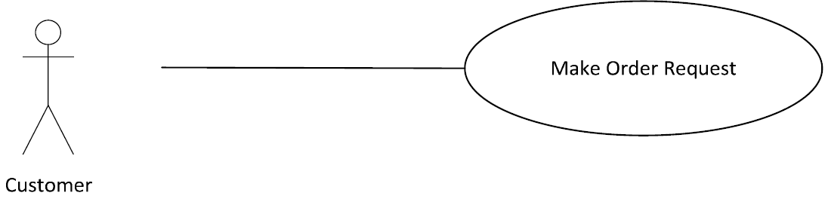
Use case: Market Order Request

Slide 28
Use case: Market Order Request
Actor: Customer
Precondition: Customer has selected one or more catalog items
Description of main sequence:
1. Customer provides order request and customer account id to pay for purchase.
2. System retrieves customer account information, including the customer’s credit card details.
3. System checks the customer’s credit card for the purchase amount and, if approved, creates a credit card purchase authorization number.
4. System creates a delivery order containing order details, customer id, and credit card authorization #.
5. System confirms approval of purchase and displays order information to customer.
6. System sends email confirmation to customer.

Slide 29
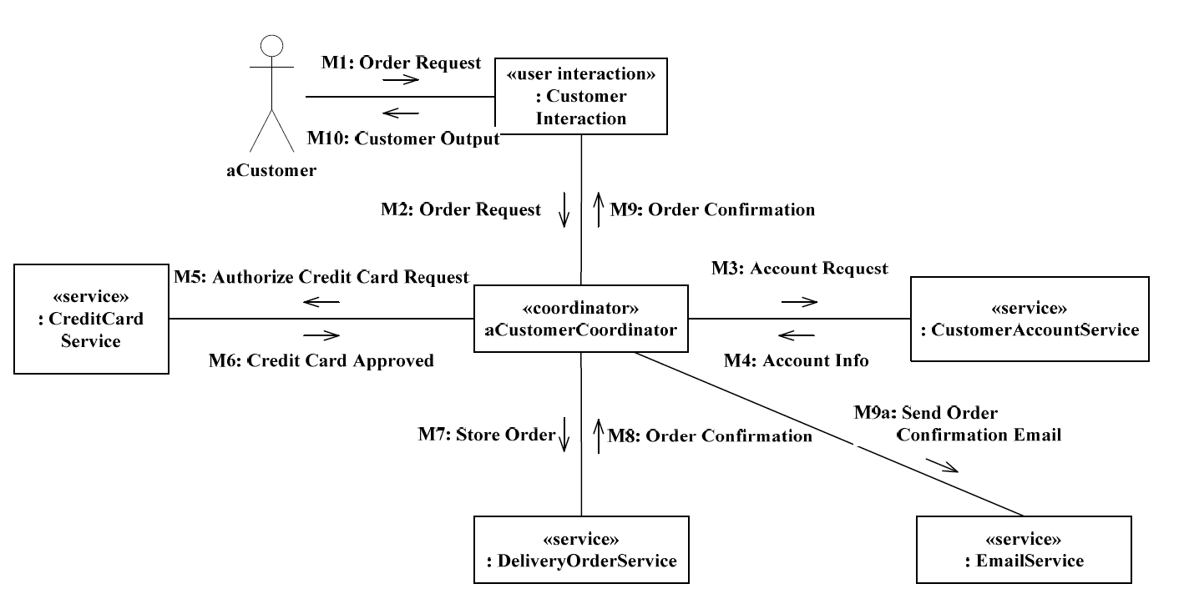
Communication Diagram: Market Order Request-main sequence

Slide 30
Summary
Static Model: Classes in UML notation
Make sure you have stereotypes applied next to the class name
Write attributes so you have idea what contents are being stored or used in the class object
Communication Diagram: Connection of objects to show information flow of an use case
Steps of main / alternative sequences represented as arrow.
Make sure unify labeling and write sequences on arrow to show data flow
A LOT OF WORK NEEDED

